Slide 1
Welcome to Arabic Level I by Kurzban

Slide 2
Lesson 14:
Objectives:
Review
Identifying Letter Haa, Mim, lam, and kaf
objects from immediate environment
Expressing Possession.
Practice
Aida Bogomolova The arts of Belly dancing
https://www.youtube.com/watch?v=fD9StRmeOXM
Click on these links to learn how to dance
https://www.youtube.com/watch?v=tGFw-RO3Hdc

Slide 3
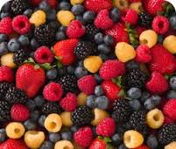
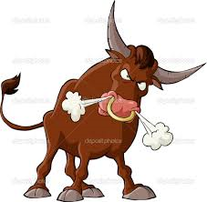
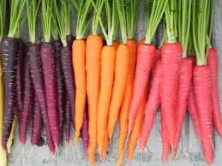
Do you recall the name of these objects? Use this is for M and This is for F

Slide 4
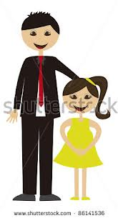
Ha at the end: Most likely will be used as (his/hers)
ب+ن+ت+ه+ا=
ب+ن+ت+ه=

Slide 5
Lesson 13: Building up your vocabulary
Copy down and translate the following words on your paper several times and remember to proceed from right to left.
Use this is: F?M?
كِتابٌ
Ketaboun or Kitaab

Slide 6
Lesson 13: Building up your vocabulary
Copy down and translate the following words on your paper several times and remember to proceed from right to left.
_________هاتِفٌ___Hatifoun
Haatif____

Slide 7
The letter “Kaf”. It’s like ha, it changes its shape depending on how it is joined:
If it stands at the beginning or in the middle of a word, it looks like this:
If it stands on its own or is at the end of a word, it looks like this:

Slide 8
كwhen it stands alone
سكر
in the beginning or the middle of a word

Slide 9
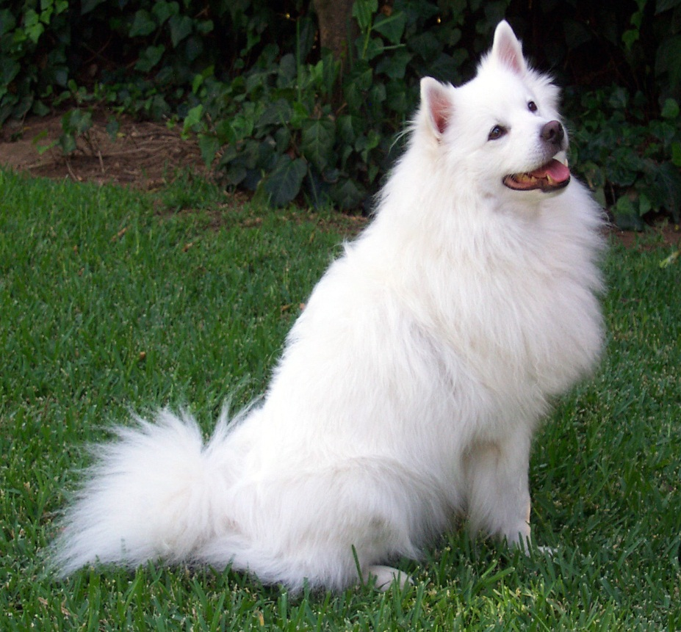
Let’s practice with kaf
ك+ل+ب=
Kalboun or Kalb

Slide 10
Practicing with Kaf
ك+ع+ك=Kaakoun or
Kaak

Slide 11
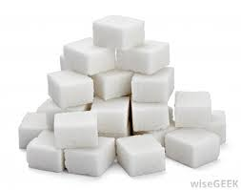
Practicing with Kaf:
س+ك+ك+ر=
Sokkar

Slide 12
Practice connecting the letter Kaf
كُ+رْ+س+ي=
ر+و+كِ+ي=
زَ+رْ+قْ+طُ+و+ك=

Slide 13
Lesson 13: Expressing Possession
One way of expressing possession is by using a phrase made up of the adverb_عـندك Literally, “at” and an attached pronoun.
Together they form one word, Thus, in order to say to some one, “You have a note book,”? You begin with the word عـندand the attached pronounـ ك {ka}, “you”

Slide 14
Lesson 13: you have? عـندك
عـندك هاتف؟نعم عندي هاتف.
عـندك هاتف؟نعم عندي هاتف
IF you are done with these slides, please click on the Belly Dance video and learn some moves. I understand that some of you might not be into it, that’s ok, practice and have fun. I will see you all on Wednesday for a Henna party.

Slide 15
Lesson 13: Building up your vocabulary
Copy down and translate the following words on your paper several times and remember to proceed from right to left.
:use “this is” F? M?

Slide 16
Lesson 13: Building up your vocabulary
Copy down and translate the following words on your paper several times and remember to proceed from right to left.
Use “this is” F?M?

Slide 17
Lesson 13: Possession
Translate and answer the following questions:
1] You have a notebook?
2] You have a pen/pencil?
3] You have a book?

Slide 18
Lesson 13:My name?
We have worked with another possessive suffix which we have used when you introduced yourself. إسمي
The final long vowel “ya” in this case is an attached pronoun, meaning “ My”.
So to summarize, if you want to say: I have; use
عندي
To say “my book: use كتابي

Slide 19
Lesson 13: Practice
Work with your partner or your group and write down 5 sentences in Arabic. Your partner should be able to read it fluently and be able to translate it.
Hand in your paragraph as an exit ticket for the day.

Slide 20
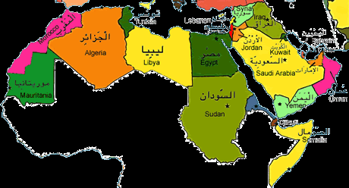
Lesson 13: Inquiring about and identifying Arabic Cities
The map below displays some of the names and locations of some Arab cities.

Slide 21
Combine the letters in each set, including short vowels, to form words

